Slide 1


The Writing Process

Slide 2

An Overview
Any well written document gets the job done and makes you look good
Generating Information
Prewrite: Spend quality time prior to writing
Consider needs of audience
Write: Stating gathered data/information
Choosing the communication channel
Rewrite: Revise the rough draft
Test for usability
Perfecting your document

Slide 3

Prewriting
Both internal or external
To inform, instruct or persuade and build trust
Choosing communication channel according to audience and purpose
Gathering data
FAST NUCES - Technical and Business Writing - Ms. Aniqa Jahangeer

Slide 4


Writing
Organize content according to pattern
Use figures and tables to clarify content
Format the content for ease of access

Slide 5

Rewriting
Test for usability
Adding details
Deleting wordiness
Simplifying words
Enhancing the tone
Reformatting your text
Proofreading and correcting errors
Revise your draft
Format the content for ease of access

Slide 6

Prewriting
Examining Purposes
Gathering Data
Determining Goals
Determining the most effective communication channel
Considering Audience
Deciding what action you want your audience to perform

Slide 7

Examine Your Purpose
External Motivation
Internal Motivation
Someone has asked for you to communicate
Initiate communication of your own accord

Slide 8

Determine your Goals
Accepting your point of view
Directing actions
Informing audience of facts/concerns/questions you might have
Build trust and rapport by managing work relationship

Slide 9

Communicating to Persuade
Writing goal: Change other’s opinions and/or company policies
Acceptance of point of view

Slide 10
Communicating to Instruct
Instructions are a big part of ethical communication
Email to subordinates for procedure of a task
Employee form
Researching documents
Reports
Customer help center providing written or oral instruction to resolve a problem

Slide 11
Communicating to Inform
Sometimes correspondence limited only to inform
Inviting staff to upcoming meeting (with an agenda)
Letter of inquiry
Objectively showing information
Trip report
Corporate entry blog (company activities, products and milestones)

Slide 12

Communicating to Build Trust
Building rapport
A positive tone is crucial to a successful work environment
Acknowledgment
Recognize goals
Recognition

Slide 13
Consider your Audience
You will not write the same way to your boss as you would to your subordinates
High tech audience
Low tech audience
Experts in your field
People with some knowledge of your field
Issues of diversity must be considered in technical communication

Slide 14

Gather your Data
Personal dates
Actions required
Locations
Costs
Methods for implementing suggestions

Slide 15



Prewriting: Techniques
Answering the reporter’s questions
Storyboarding
Mind Mapping
Creating organization Charts
Brainstorming or listing
Flowcharting
Outlining

Slide 16

Channels of Communication

Slide 17
Determining Channels of Communication
Instant Message
Website
Letter
Blog entry
Memo
YouTube video
Report
Proposal
Email
Flier/Brochure

Slide 18
Single Sourcing
Producing documents designed to be recombined and reused across projects and social media
Versatile audience
Variety of communication channels

Slide 19

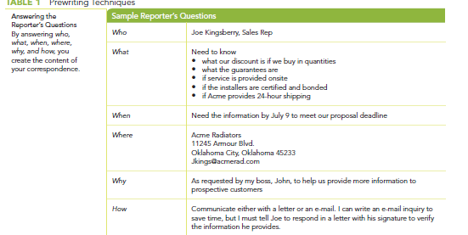
Reporter’s Questions
Answers who, what, when, where, why and how
Helps create content for correspondence

Slide 20

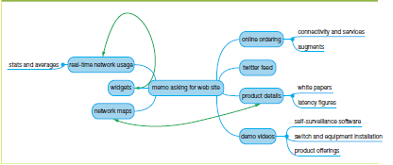
Mind Mapping
At the center is your topic
Allows you to look at your topic from multiple perspectives
Cluster the similar ideas

Slide 21

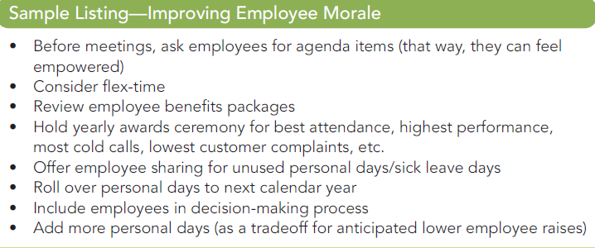
Brainstorming or Listing
Either individually or in a group
Suggest random ideas (brainstorming)
Make a list of these suggestions
Valuable for team projects

Slide 22

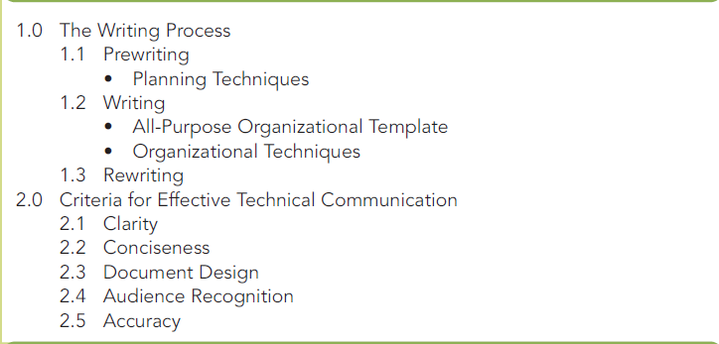
Sample Topic Outline
Traditional format for gathering and organizing information
Allows you to break a topic into major and minor components
All-purpose tool

Slide 23
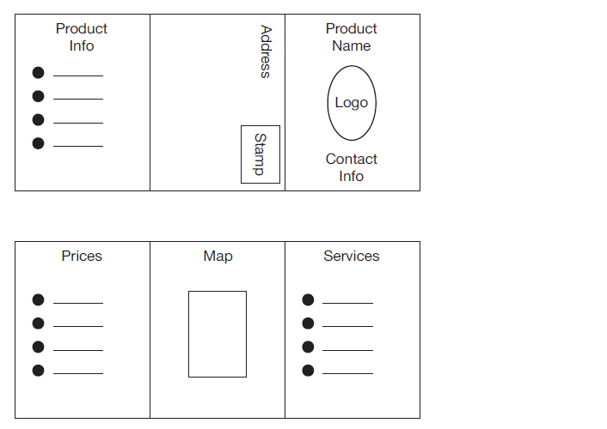
Sample Brochure Storyboard
Visual planning technique
Graphically sketch each page or screen
Helps visualize your technical document/correspondence

Slide 24
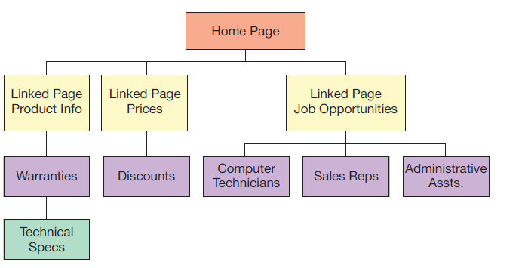
Sample Organization Chart
Overall organization of a document
Helps with the subdivision(s)

Slide 25
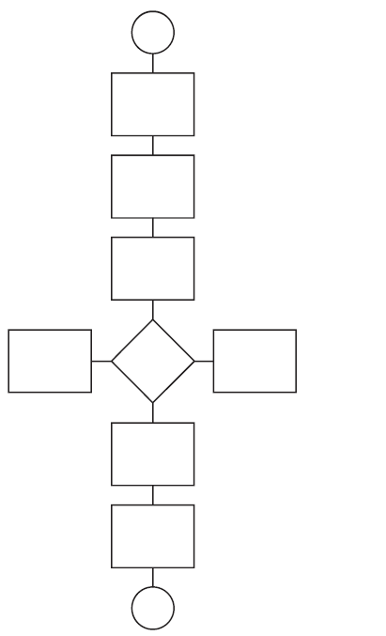
Flowcharting
Useful for gathering data
Especially useful for organizing content chronologically
Stop/Start
Step
Decision

Slide 26
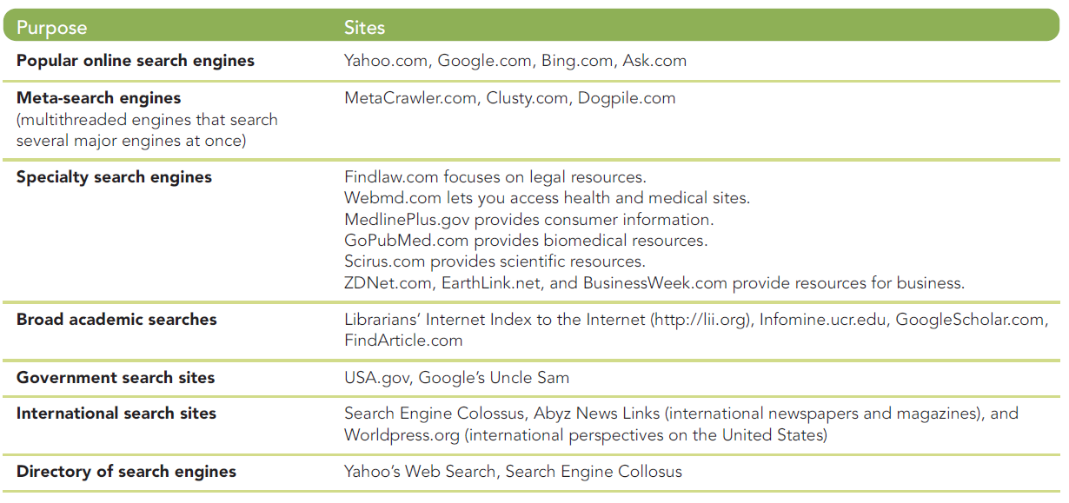
Internet Search Engines

Slide 27
Channels of Communication
Communication Channel | Benefits | Challenges
Email messages, instant messages (IM), text messages (TM) | Quick, synchronous, real‐time electronic communication with one or more readers. Limited characters Attachments | Less formal Not private if company administered Size limitations
Letters | Official corporate letterhead Formal correspondence for outside company readers | Time consuming Attached documents can be costly or result in bulky envelopes
Memos | Internal correspondence (coworkers) and greater privacy Limited length but can attach documents | Time consuming Less formal

Slide 28
Channels of Communication
Communication Channel | Benefits | Challenges
Reports and Proposals | Internal and external Very formal 1 page-100s of pages give detailed information | Time consuming
Brochures and fliers | Informational and promotional communication to large audiences | Limited size: brochure 6 panels on back and front; fliers one page long
Web sites and blogs | Informal and public communication in unlimited size Can be updated and include links to sites, animations etc. | Access to internet Can reveal sensitive information

Slide 29
Channels of Communication
Communication Channel | Benefits | Challenges
Oral presentations | Formal and informal Direct audience interaction | Communication inhibitions Audience can be poor listeners
Social Media (Twitter, Facebook and YouTube) | Rapid communication with people Friendly, informal manner of communication | Poses confidentiality issues Time consuming on work
Videos | Avoid language barriers Clear actions for people to follow Can be entertaining | A precise script and directions for video are challenging, time consuming and expensive.

Slide 30
Writing
Helps draft your writing in logical sequence
Organization
Formatting
Organization
Organizational methods are not mutually exclusive and can be used simultaneously
An unbroken page or screen of text is not reader friendly so highlight and make information accessible

Slide 31

Rewriting
Determine its usability
Determine its correctness

Slide 32
Usability Testing
Usability testing helps you determine the success of the draft
Retrievability : Can the user find specific information quickly?
Readibility : Can the user read and comprehend information?
Accuracy : Is the information complete and correct?
User satisfaction : Does the document present information in a way that is easy to learn and remember?

Slide 33
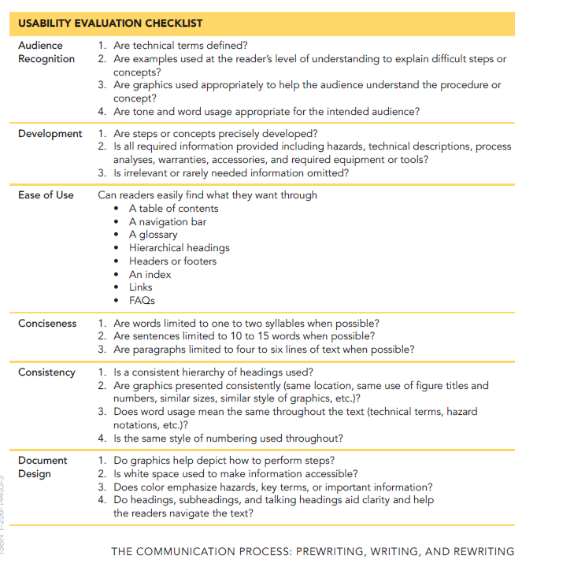
Checklist

Slide 34
Revision Techniques
Add missing detail for clarity
Delete dead words and phrases for conciseness
Simplify words for better understanding
Ease of access of information
Enhance tone and style of text
Grammar and mechanics

Slide 35
Activity (Pair work)
Write a social media campaign post (you can be creative, and it can be of a social, cultural or environmental nature) for a company keeping in mind the conventions of sentence structure and organization for a small paragraph that we have discussed so far. Address reporter’s questions before drafting the post. Your final draft for the post must not be more than 100-150 words. In addition to writing it, chalk out details like the suitable layout, tone and hashtags for gathering attention on socials. Mention the tone chosen before the start of the rough draft as well.
Prepare the answers to reporter’s questions and a rough draft for the post in a word document.

